Slide 1
Fire sales

Slide 2
1.Table of contents
.1.Intruduction of Members
.2. Our understanding of teamwork and rolls
.3. Ideas

Slide 3
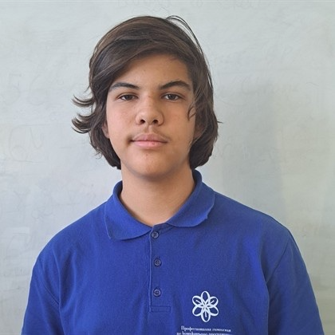
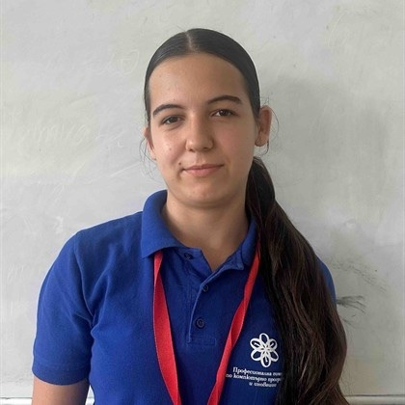

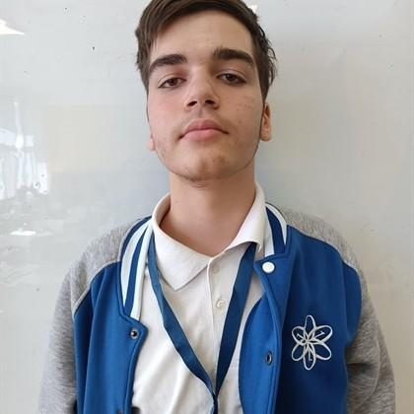
.1.Members
Vasil
Zarakqn
Siqna
Peeva
Joan
Georgiew
Mihai
Mavrodiev

Slide 4
.2.teamwork and rolls
Most of us understood each other .
We understude are rolls and what we needed to do .

Slide 5
3.Idea
We had some ideas in the beginning but not to many.

Slide 6
4.How we communicated
We mostly used teams.

Slide 7
Thank you for your attention

